Slide 1
Suppliers sourcing in Alibaba
Oded Guy

Slide 2
What is Sourcing? from china?
Product sourcing is the process of buying product inventory from a supplier and then reselling them. Common product sourcing methods include finding a manufacturer for custom products, purchasing third-party goods from a wholesale supplier, and partnering with a dropshipper.

Slide 3
Sourcing Methods
Work with a Known Supplier that you have relations with.
Look at products, find the manufacturer on the packaging
Go to designated trade shows in your local area
Go to China Markets: Yiwu, Shenzhen
Go to China Trade show: The Canton fair
Source from Alibaba, with no expenses, from the comfort of your home…..

Slide 4
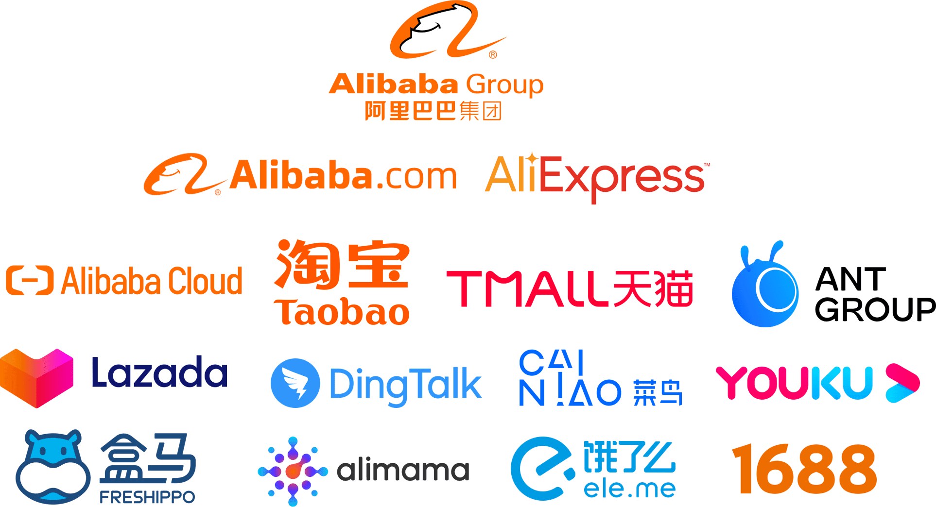
What is Alibaba?

Slide 5
What is Alibaba.com?
Alibaba is a searching platform for suppliers, factories, trading companies, and more… mainly for suppliers
Basically you can see it as the starting point for e-commerce businesses

Slide 6
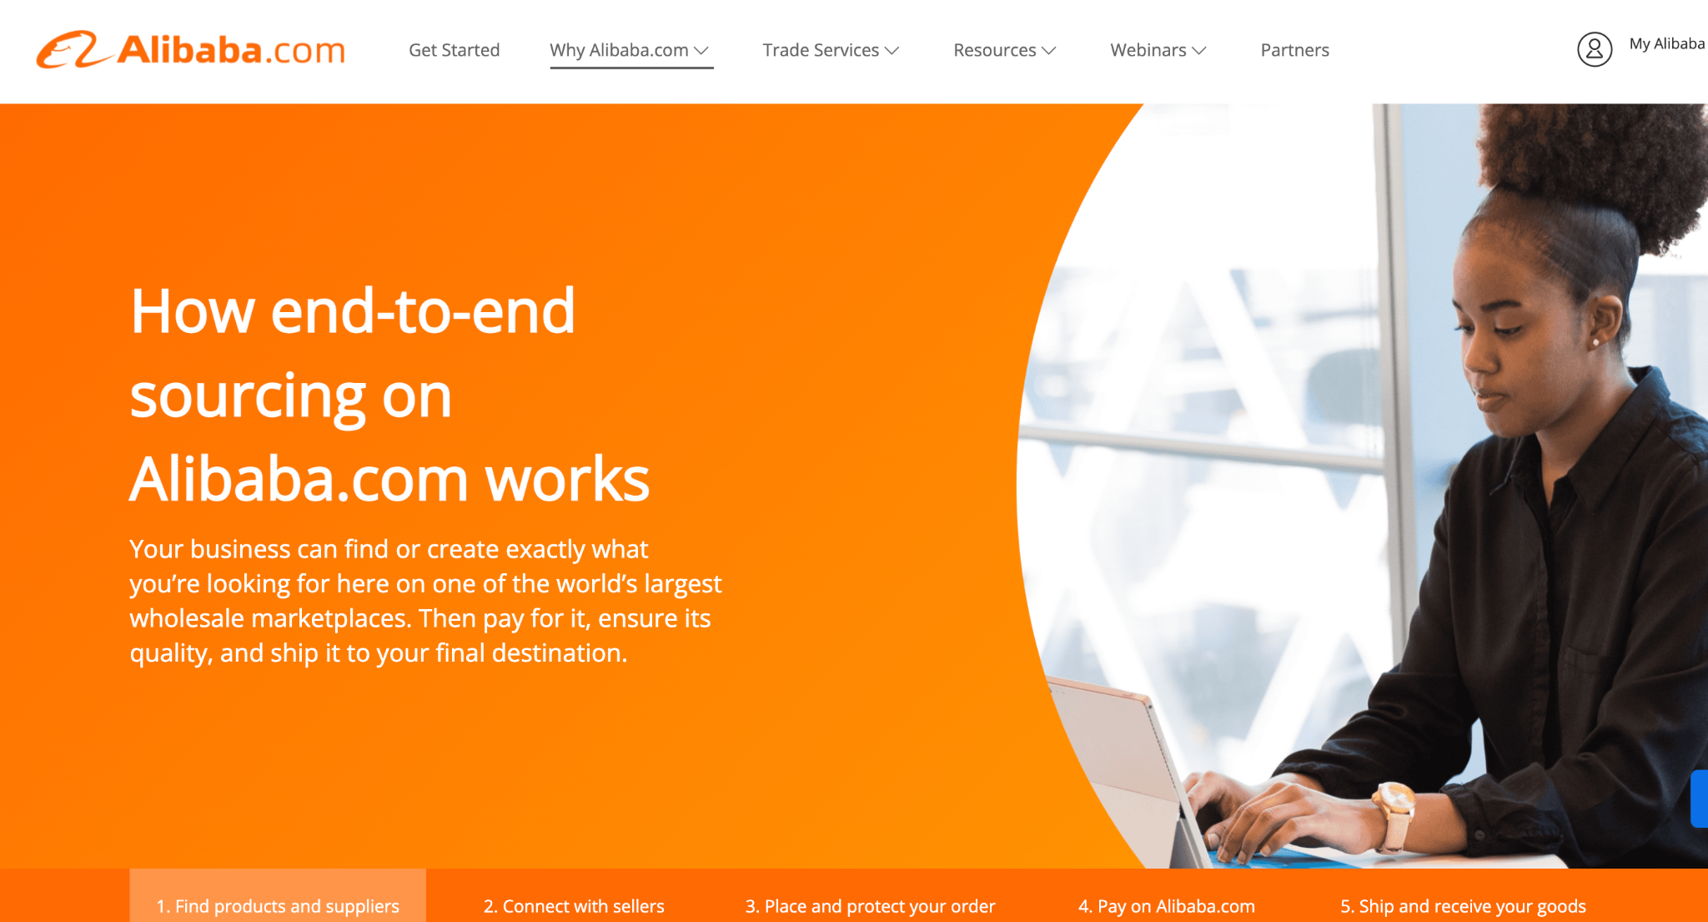
Alibaba - end-to-end

Slide 7
How to find the right suppliers?
ר
Search by supplier
Trade assurance
Gold supplier
Verified supplier
Product page details are not relevant
Number of years
Company name
Relevant products catalog
sales agent in most cases, not the real factory owner

Slide 8
Basic Terminology
OEM - Original Equipment Manufacturing (iphone)
ODM - Original Design Manufacturing (Private Label / white Label)
Moulding - Mould Design , Mould Ownership, Mould = Moat
MOQ - Minimum Order Quantity (based on volume tiers)
Inspection - Factory inspection, Product inspection, Loading inspection
Trading Company - Agent - MiddleMan - Not a direct factory - Ok.
HS Code - Harmonized System Codes

Slide 9
HS code - Customs
What is the HS code?
Ask your suppliers for the HS code
How does it work in the customs – different fees for different countries
Trump’s increase at the war between the US to China (Tariff)
Declare 70% of the goods real value
Ask the shipping carrier for the HS code and for the best classification for your product.
Don’t try to mess too much with it to not get punished (don’t declare too low and don’t put a wrong HS code).
Ship as DDP - Delivery Duties Paid - Service by the forwarders.

Slide 10
Get a price estimation
Opening few dozens of listings before reaching out to the suppliers and making an estimation of the price between them – to see if this product can still be profitable in some way
Notice different product variations (cutting boards)
Notice different product quantities and MOQs

Slide 11
Presentation of You and Your Business
They want your business! but they have other leads and clients
Present yourself as an established business. get better in time.
You are NOT the business owner. you need to have someone above you! for negotiations
Have a business name, email, domain, website…
They are checking you, same as you are checking them - this is a marketplace….

Slide 12
Prepare The RFQ Template - Info Sheet
Prepare a template nof your product specs - Information sheet - as much details as possible.
Get ready with your template of basic and general questions (not so many) about any product/
Ask for a price of 2000 \ 3000 units (for quoting purposes)
Check with them 1 by 1 the must to have features in the product.
Take them out of Alibaba to Wechat.
Ask them all the rest of the questions from the bad reviews of the product + HS code* - all in 1 excel template.
Negotiate with them by showing them the other offers but not too much – to not risk the quality
Priorities : Quality - Relationship - Price

Slide 13
Deep Dive with the top winners
Select the top 2-5 options. DO NOT GO WITH JUST 1-2.
Send a designated Template Reply to all the top and ask more questions.
Check with them 1 by 1 the must to have features in the product.
Take them out of Alibaba to Wechat.
Ask them all the rest of the questions from the bad reviews of the product + HS code* - all in 1 excel template.
Work with them to develop YOUR product: Differentiation, Packaging, Optional Upgrades, Newer models, etc.
Negotiate with them by showing them the other offers but not too much – to not risk the quality
Priorities : Quality - Relationship - Price

Slide 14
Sourcing Roadmap
Prepare your product Info Sheet - Specs Sheet
Prepare your RFQ Template email request.
Send the RFQ to as many relevant suppliers as possible : Dozens…
Evaluate and Screen the replies, inside Alibaba
Send the Follow Up email with more questions to the good ones.
Choose the top 2-5 Winners and keep negotiating
Develop your products and order, learn and improve the process.
Negotiate pricing, terms, conditions.
Finalise with the top winner. not only based on pricing.

Slide 15
Factories in China
Based in Regions - based on materials and craftsmanship
You will ship from the closest port to your factory region.
Big / Small / family Owned / Government Owned….
Many DIfferent types of Factories….
The Factory Boss ! The Boss room
The Sales Representatives - young hungry educated chinese.
Rich Factory / Poor factory
You can be the Biggest Client - Or the Smallest Client
Find the factory where your competitor is manufacturing.

Slide 16
Culture
The relationship is their highest priority, not like us
Treat them like a stupid baby
Be very specific in your questions
Follow up with them because they won’t do so.
Don’t accept giving your contact details so easily to them – they will keep chasing you.
Business card is not that important – you should keep it empty if you don’t want them to bother you.
Don’t be surprised if they will try to “court” you – just do the same.
They will say “yes” to anything, so don’t let them fool you.

Slide 17
Wechat – shows you are serious
Quick background about what is it. How to use it Why does it make look serious In Front of them if you have your own Wechat

Slide 18
Sourcing - build a relationship
Relationship is Very important.
Starting from the first email presentation
How would you present yourself
Once you start working with a supplier - build that relationship
Relationship leads to more cooperation and success
Relationship helps you negotiate in the future
Relationship helps you get ahead of the competition (in that factory)

Slide 19
Sourcing - Multiple Suppliers
Sourcing Relationship are Temporary and non-singular
Work with multiple suppliers for the same products - at the same time
Rotate between suppliers / work simultaneously
Shift supplier upon new order - new RFQ, with your current volume
Packaging Supplier / Accessory supplier
Develop the relationship - Get Terms: Payment terms: 10%-90% Lead Time terms: Get inventory in 20 days Supply chain terms: Supplier stor goods and drip feed them into FBA
Work with different suppliers for different products - multiple

Slide 20
Sourcing Roadmap
Prepare your product Info Sheet - Specs Sheet
Prepare your RFQ Template email request.
Send the RFQ to as many relevant suppliers as possible : Dozens…
Evaluate and Screen the replies, inside Alibaba
Send the Follow Up email with more questions to the good ones.
Choose the top 2-5 Winners and keep negotiating
Develop your products and order, learn and improve the process.
Negotiate pricing, terms, conditions.
Finalise with the top winner. not only based on pricing.

Slide 21
questions?

Slide 22
Thank You
www.negev-prime.com

