Slide 1
Listing - דף המוצר - דניאל ברלי

Slide 2
Product Listing - Why Invest
Millions of products, thousands of related products, hundreds of competitors and me. I need to be ME!”
Standing Out!
Our product and its page need to be spotted and attractive!
Attraction + conversion is the game.
דניאל ברלי | דף המוצר

Slide 3
Our Goals
Conversions (to sales) with minimum opting out or returns
Indexing well Our Long and Short tail Kws
Both will lead to better Relevancy by Amazon
The Holistic View:
Through the listing page we communicate our product to 2 main target audiences:
The potential buyer/customer
To Amazon - And with our attempt of what we wish it to know about our product
דניאל ברלי | דף המוצר

Slide 4
Breakdown the purpose of the Listing
Our purpose is to make the listing SO GOOD that once the RIGHT customer lands on it, he gets the the right impression from our listing and product. From his point of view that would mean:
He got to the right product he was searching for
The listing transmits quality, assurance and cleanness
The important info is presented immediately & efficiently
The customer has become inquisitive enough in scrolling down
The more the customer stays, we gives us a better chance convincing (and maybe sympathise) him to trust and wish to buy our product
He find our price to be a good one for what we offer.
The info presented does not make him tired
דניאל ברלי | השקת מוצר

Slide 5
Be the Wolf or maybe the Sheeps have a point?
A Dilemma:
We have so much information just by looking at the best competitors of our product.
Should we imitate, copy the winners? Should we change to be different?
The choice is hard….
Let’s talk for a sec….
דניאל ברלי | השקת מוצר

Slide 6
A Sheep With Wolf Teeth Is Stronger Than Both?!
The best of both worlds
The comparison of the Alfa’s
The best ones made some testing for us,
As for the rest, we should do split testing
(Pikfu, AMZ Experiments with BR)
דניאל ברלי | השקת מוצר

Slide 7
The Listing Structure - General
Some main points to remember
The listing in its original in amazon, is not ours. It is amazon’s
Also, other sellers of the product, can change the information in “our” listing.
By using certain legal tools, we can gain “authority” on the listing. This is SUPER important to gain.
In time we could witness the structure of the listing changes/not the same with all listings, this usually happens when:
Different Categories are involved
Change, it's a long term friend here
Periodically, Amazon might change/test some listing subcategories relations to top categories
Have horizontal change on Amazon all listings, which have not been made to all simultaneously, takes time..
Main structure of the listing is combined out of:
Main parts: Title, images, bullet points, description/EBC, Q&A, PR (Product Reviews) section.
Secondary Parts: Amazon platform’s special info spots, Amazon Sponsored Ads (ASA) spread in various places, frequently bought together ...
3rd Party add-ons: Like Keepa, H10, special offers section…
דניאל ברלי | השקת מוצר

Slide 8
The Listing Structure: “Ingredients”
What do we need to prepare:
KWs & Phrases
Make sure you analyse well Main KW & Main Phrase (short and Long tail)
Most valuable Main KWs (aside from the main), and Phrases
2nd level KWs and 3rd level KWs
There are tools which help analyzing the KWs aspect:
For what KWs - H10’s cerbrow, magnet & more
For how to sort & minimise quantity - H10’s Frankenstein, scribbles, listing builder….
The information we wish to transmit the customer: about our product’s features / benefits / our brand / most logical answers to questions/common issue we believe would be relevant / the Big Way us / If possible try to have in mind designated crowd… We can always improve after
Images - Also priority,
Videos, if we have.
Brand content: Registered or in process (If not, have a name that was checked for this), logo, if we have Brand registry in process - Great!
דניאל ברלי | השקת מוצר

Slide 9
The Listing Structure: The Title
The Title The MOST important factor to be found in the right places
Characteristics:
Most important part of the listing. Main source of being found when searched.
Length: usually between 200-250 characters
Depended on the category.,, could change along the years.
Don’t exceed or it is lost
Strongest: This is where we place the strongest Kws/Phrases we wish to be ranked for the most.
Strongest inside the title - From left to right, what's first.
דניאל ברלי | השקת מוצר

Slide 10
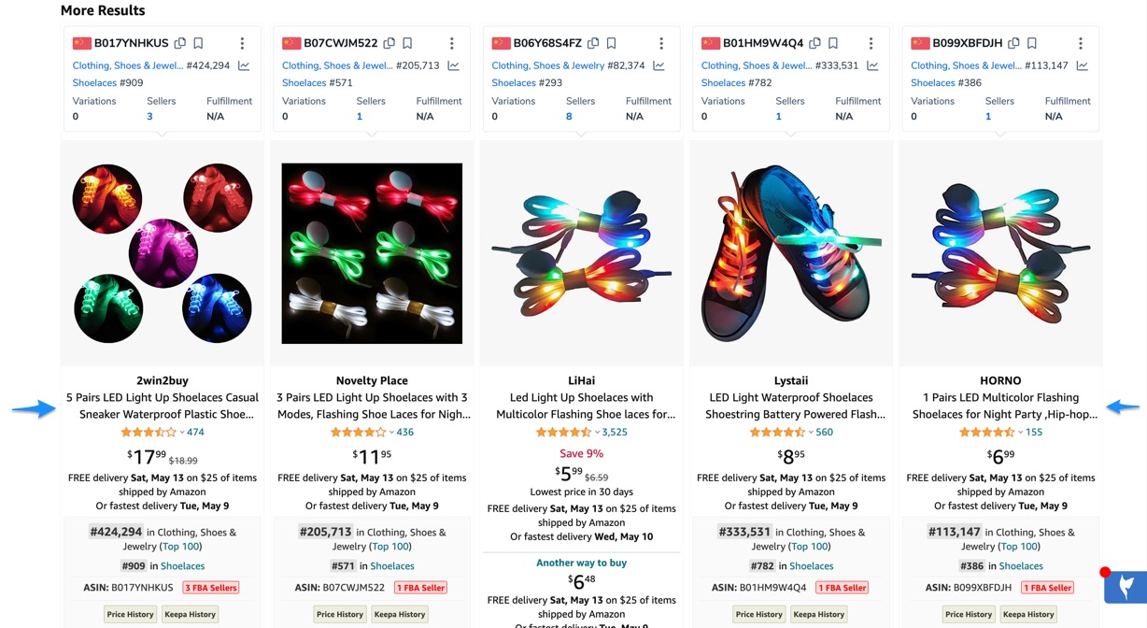
The Listing Structure: The Title - 2
Title - Just a quick view - All are almost the same
דניאל ברלי | השקת מוצר

Slide 11
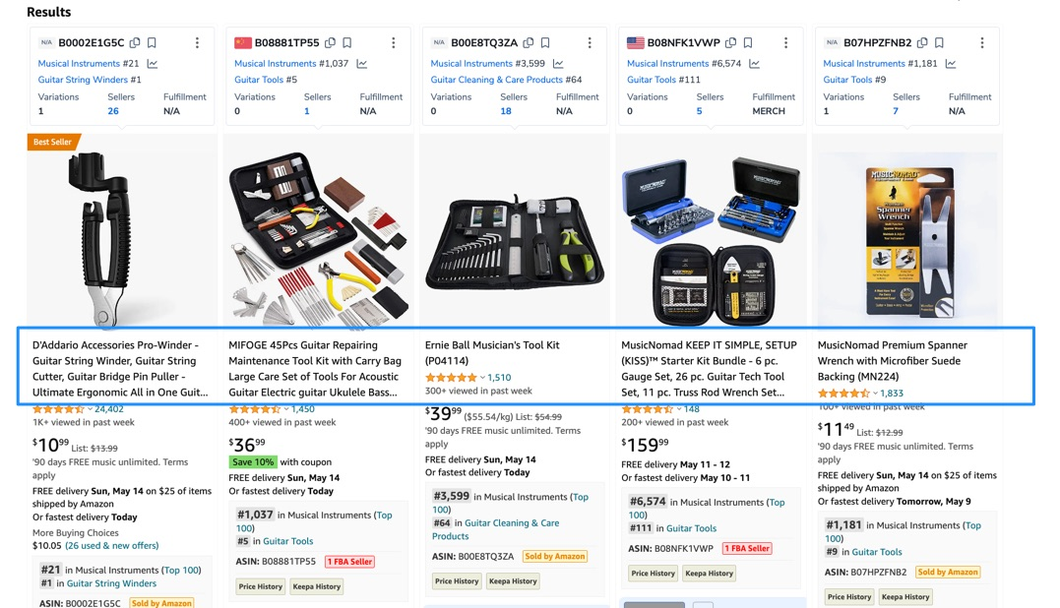
The Listing Structure: The Title - 3
Title - Just another view - Sometimes some aim differently and some just miss
דניאל ברלי | השקת מוצר

Slide 12
The Listing Structure: The Title - 4
Title - Do’s or Don’ts:
Many KWs but with style:
We wish to place as many as we can, but still having the title “proofread” (logic and nice, not nonsensical)
Changes in the title:
Sometimes when changing the title, this could bring a lot of change to the sales (both directions). Best to make changes in the first 3-5 weeks of the launch where it is more “forgiving” (The “Honeymoon story”). But later, if need to be, than it needs
to be.
Priority inside the title:
Most important info of your product - place it first!!!
First 5 words are what Google will index as canonical URL
Priority of the massage - Make sure that it is clear from the first 30-40 character in the title, what is the product or your main massage/ information. The earliest the better (also by strength). Also title might break visually.
Positive “vibe” to the text is better (or neutral, just not negative terms: “bad”, “no”, “never”), unless the Negative describes our product the best.
Important info (technical) relating to the search of the customer (size, volume, the Perceived Value if possible...)
דניאל ברלי | השקת מוצר

Slide 13
The Listing Structure: The Title - 5
Title - Do’s or Don’ts (little more):
Avoid “playing” with the text:
Some Subjective descriptive words are not recommended or allowed to be used like : #1, best, 100% guaranteed, Top … (“Puncture resistant/free” instead of “100% won’t Puncture”)
Also some characters for the purpose of decoration like: { } # < > | * ; ^….
Other brands (Adidas, Macdonald)
Adult words, obscenity
Exact verses split phrases: Using exact phrases is best but you can spread some in the title, and it will still be strong.
Look at the competitor too
If all are doing longer ones, Maybe (just maybe) check if to cut a little, or vis versa (this also will stand out). But never on the expense of the quality
דניאל ברלי | השקת מוצר

Slide 14
The Listing Structure: The Images
The Image: The MOST important factor for conversion!!!
There are 7-9 images (last 2 are not visible without expanding, today there are places spotted with 11)
All should be looking good! Also Video
The images should “speak” the designated sector of buyers (Lifestyle Image in the wrong background / demographic…)
The 1st image – Number one convertor factor! No exaggeration on how important this is.
Many would choose by the 1st image weather to buy our product.
The main image transmit lots of data that brings impression on our brand and validation.
Invest in the main image!!!!
Think what you want it to show/transmit, discuss this with the photographer.
There are rules for the main image – Do not break them! for example:
1,000 pixels min, white specific background,
No text or watermarks
No extra props (unless part of the product or required I order to understand it).
דניאל ברלי | השקת מוצר

Slide 15
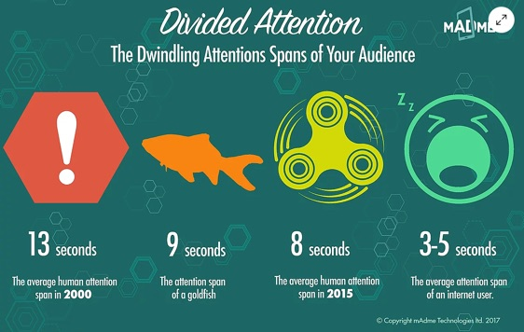
Attention!!!
One of our main adversaries is the attention span of the 2020’s
(Sourse: https://www.mad-me.com/single-post/2017/07/31/divided-attention-how-to-engage-with-dwindling-attention-spans )
דניאל ברלי | השקת מוצר

Slide 16
The Listing Structure: The Images - 2
The Image:
Things that can be done in the main image:
Product ratio in the image: - Should be in away that it is not too small
It can be on an angle
Packaging as the grey area - In many cases we would be able to add the packaging to the main image, by that reducing the white background.
Logo can be presented if on the product or packaging
TIP: Have a backup main image - One that for sure qualifies with the rules! (drop of images by AMZ or false complaint)
2nd Image is also important, due to it being part of search result images. Also, High probability it will be observed.
We want to differentiate not only our product but also our main image sometimes:
Checking how to stand out in search results (but we should not go to an extreme)
Making it better than what competitors has today.
דניאל ברלי | השקת מוצר

Slide 17
The Listing Structure: The Images - 3
Image 2-9:
Can have life style images (don’t forget such and make sure with faces and good vibe), comparison, ways of use, features, measurement clarifications…
Can also address issues that were raised and not clear
Could be addressing fixing our* features/wrong past displays, competitor’s defects (without stating in a noticeable manner)
We can consider adding a customer image, if they agree.
All the images:
Stick to the rules! - the guidelines are different between the main image and the rest.
Try to provide info through the images, which you can not make clear by using text (or wish to emphasis)
Invest in the images!!!!
KWs have no meaning here.
Videos: As one of the images, 30-60 Sec length. Can be a great tool:
To cover more information, fix
Transmit even more what your brand represents
Can include a “How to” information
It can be with people, without, animation,
דניאל ברלי | השקת מוצר

Slide 18
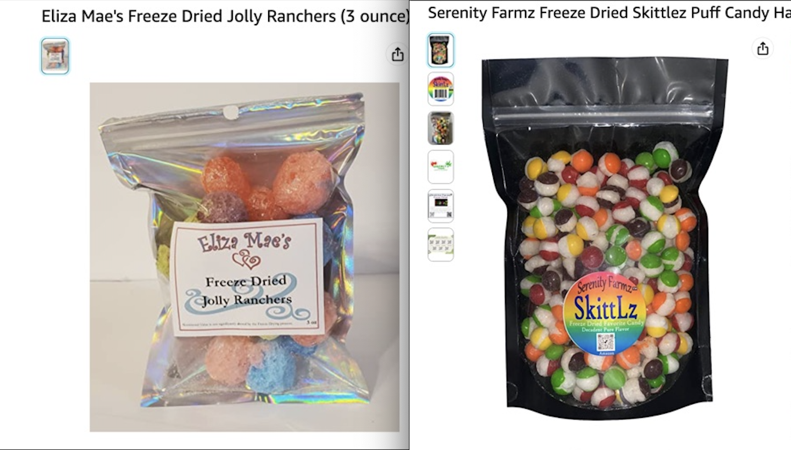
The Listing Structure: The Images - Example 1
Image Example: 2 comptetiros, one is not utilizing his listing completely (the 2nd could do better). 2.5 M$ sub market
דניאל ברלי | השקת מוצר

Slide 19
The Listing Structure: The Images - Example 1.2
Image Example: Competitor one How is he doing? How much could be better?
דניאל ברלי | השקת מוצר

Slide 20
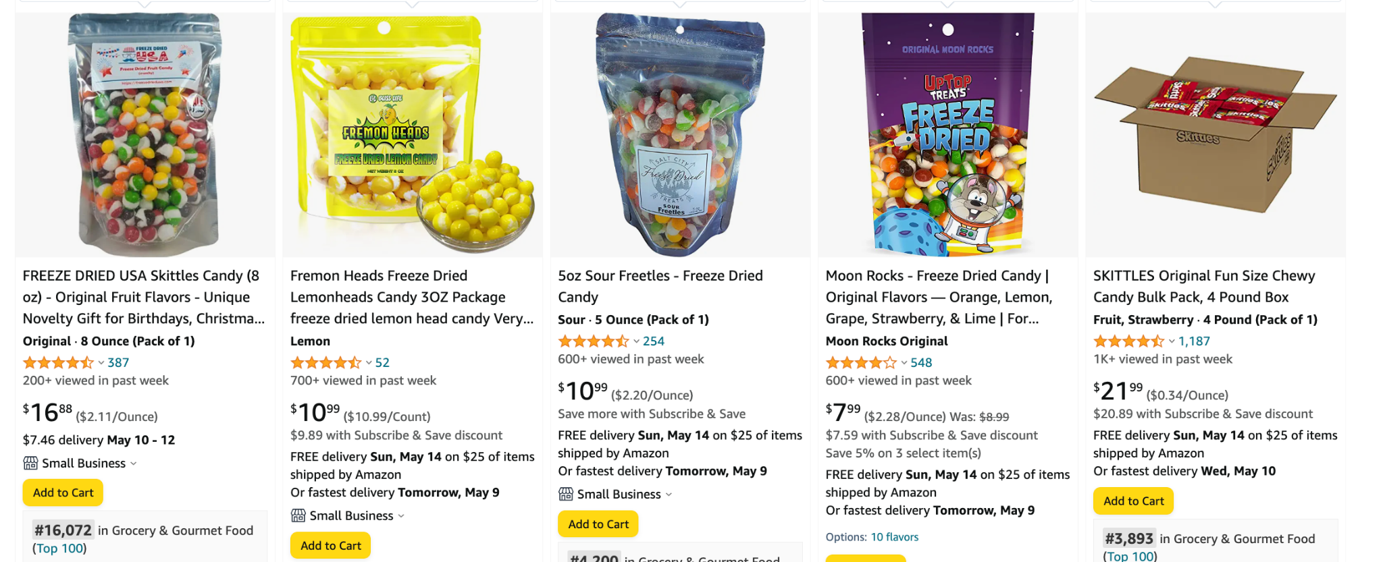
The Listing Structure: The Images - A question?
Q1: Is anyone here is violating the terms? Q2: What would you have suggested one/some of them?
דניאל ברלי | השקת מוצר

Slide 21
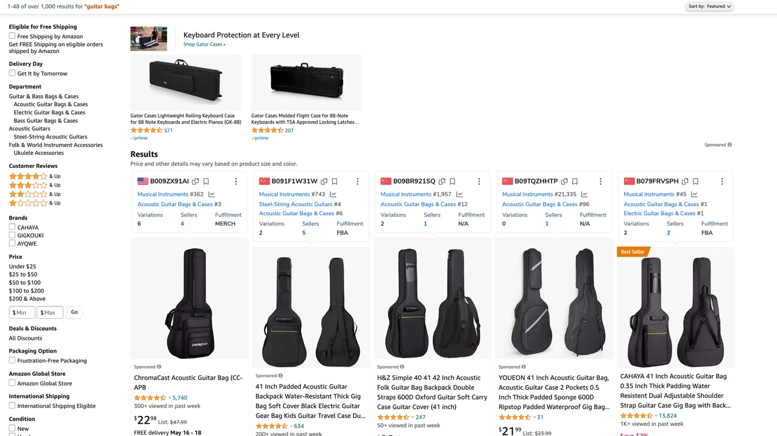
The Listing Structure: Example 1
Let see here how impactive small differences are - Guitar Case
דניאל ברלי | השקת מוצר

Slide 22
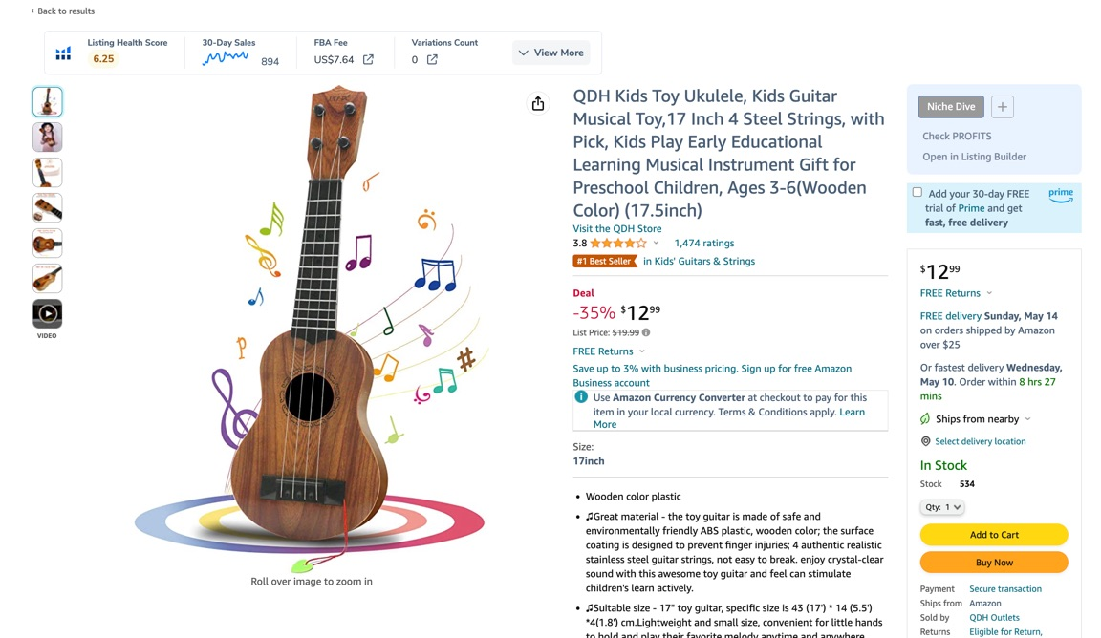
The Listing Structure: Example 2
Do not learn ALL by example!!!
דניאל ברלי | השקת מוצר

Slide 23
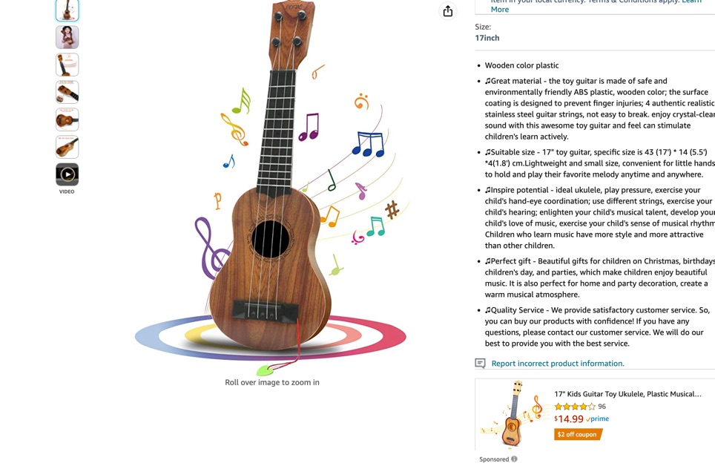
The Listing Structure: Example 2.2
Marketing does not end in “Search Results”
דניאל ברלי | השקת מוצר

Slide 24
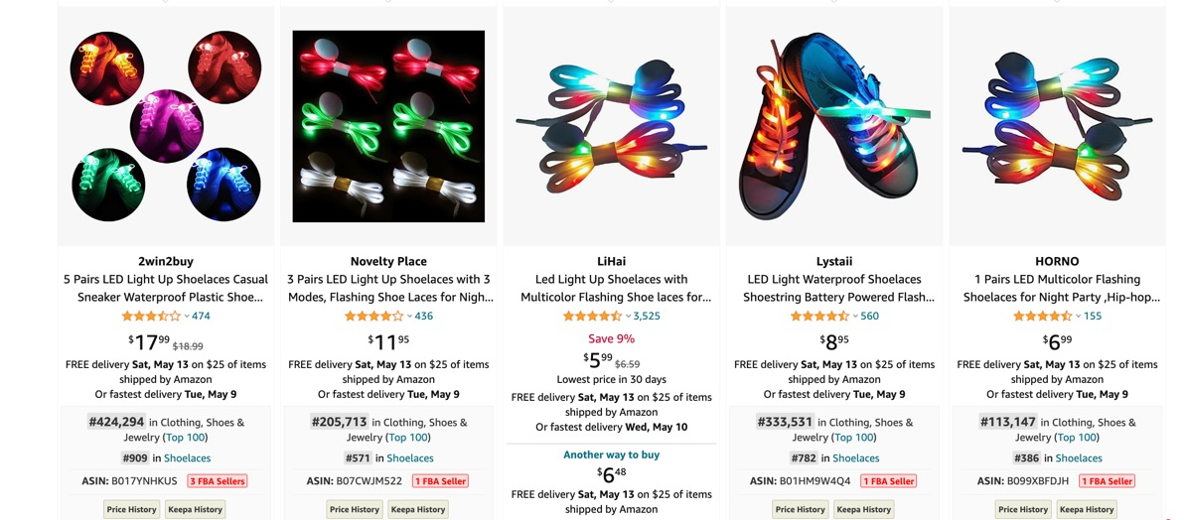
The Listing Structure: Bullet Points - Example 3
Bullet points - One example for better optimized, just next to Example 1. (Violation, verses good standing out)
דניאל ברלי | השקת מוצר

Slide 25
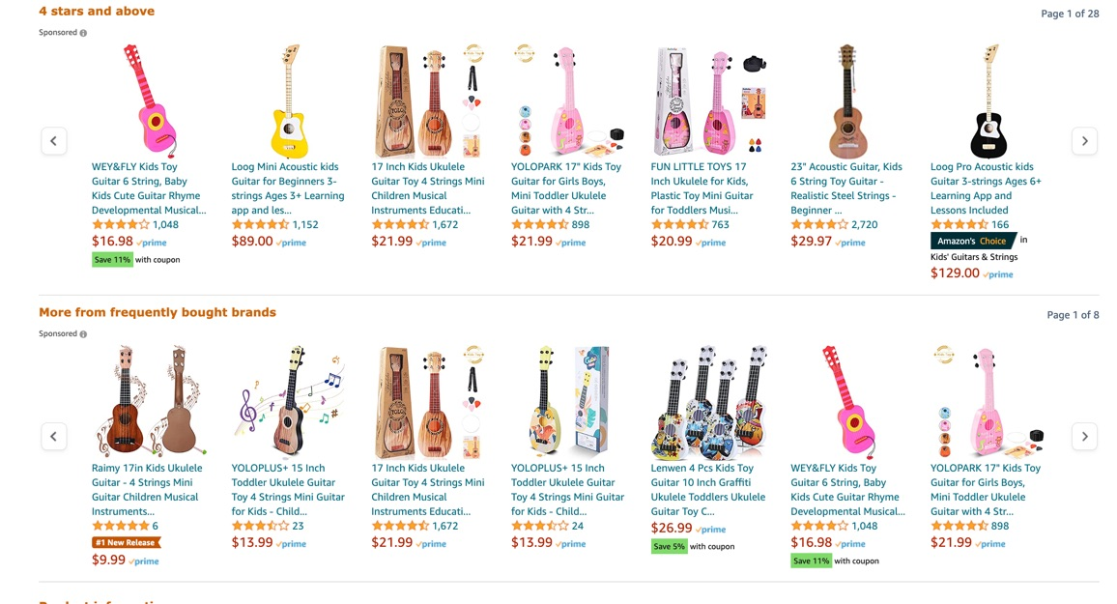
The Listing Structure: Example 3
דניאל ברלי | השקת מוצר

Slide 26
The Listing Structure: The Images - The Video
Video - So versatile and huge potential for lots more information, branding & marketing.
Missed information - Can most likely be addressed & completed here - Lifestyle, usage, scenarios….. product that it is hard to get a good image
Amplify our main massages
Movement - The big factor of Videos - Fit to crowd (attention span remember?)
Techniques - 360 degrees videos, drown, propes…
Professional video, not a must , sometimes even lesser - Quality video - Always better !!
Demographics - Aim correctly (wheelchair with young presenters, Led party shoe laces with family / young / elderlies?....) Depends no?
Just remember to keep with the guidelines and general good code of conduct
דניאל ברלי | השקת מוצר

Slide 27
The Listing Structure: Bullet Points
Bullet points
200-250 in general – Don’t make it too long, otherwise they won’t be indexed
Strong impact with Kws, higher than description but lower than the title.
For whatever left from the main Kws + Secondary Kws.
Focus on Why/Benefits our product fit/has for the customer
If you have a significant advantage to competitors, add it here and first!
Have in general 5 but depends on the category, can have more (adding when building the listing)
Top 3 are the most important ones (could be cut visually or attention spend)
Concentrate on the benefit than features
No full capital letter words, HTML, emojis
דניאל ברלי | השקת מוצר

Slide 28
The Listing Structure: Bullet Points - One method
Bullet points - One example for a method how to spread bullet points:
They go from best location to least, So by this priorities your order.
B.1 - Pragmatical benefits - Emphesis best benefits/reason (instead of presenting as features) why someone should by our product. Could relate to feelings as well if needed (No more than 200, preferably less) + KWs
B.2 - Emotional Element - Emphasis on best emotional/subjective benefits or characteristics that can connect the customer to the product. Think of basic emotions/desires (No more than 200, preferably less) + KWs
B.3 - Moral benefit - If there is something we can point out here (manufacturing in Ivory Coast, sustaining the hard working Native’s village / When buying a product 5%/10$ goes to…’Noble cause’…) + KWs
B.4-5 - Real estate, elaborate on whatever you think is best.
Or combine 1 and 2 and make twice like – Emphasising the best benefits and in the same bullet after connecting it to the emotional/desire of the customer – emotional result) what emotion motivate my customer
Many options to go about it, and longer is not necessarily better, especially for 1-3
דניאל ברלי | השקת מוצר

Slide 29
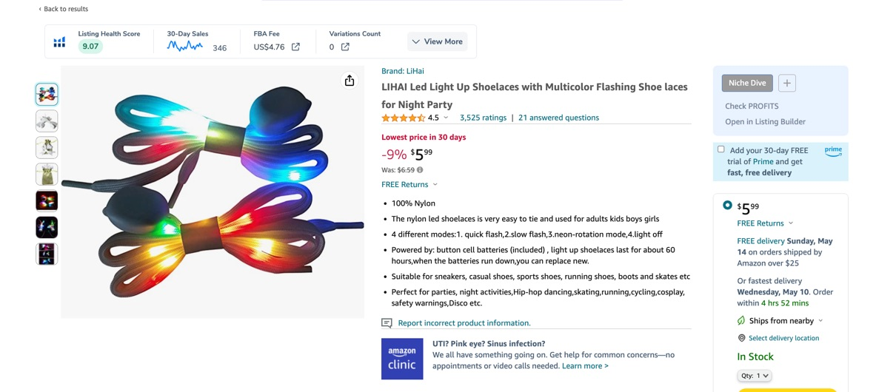
The Listing Structure: Bullet Points - Example 1
Bullet points - One example for Not fully optimized (in “real estate”)
דניאל ברלי | השקת מוצר

Slide 30
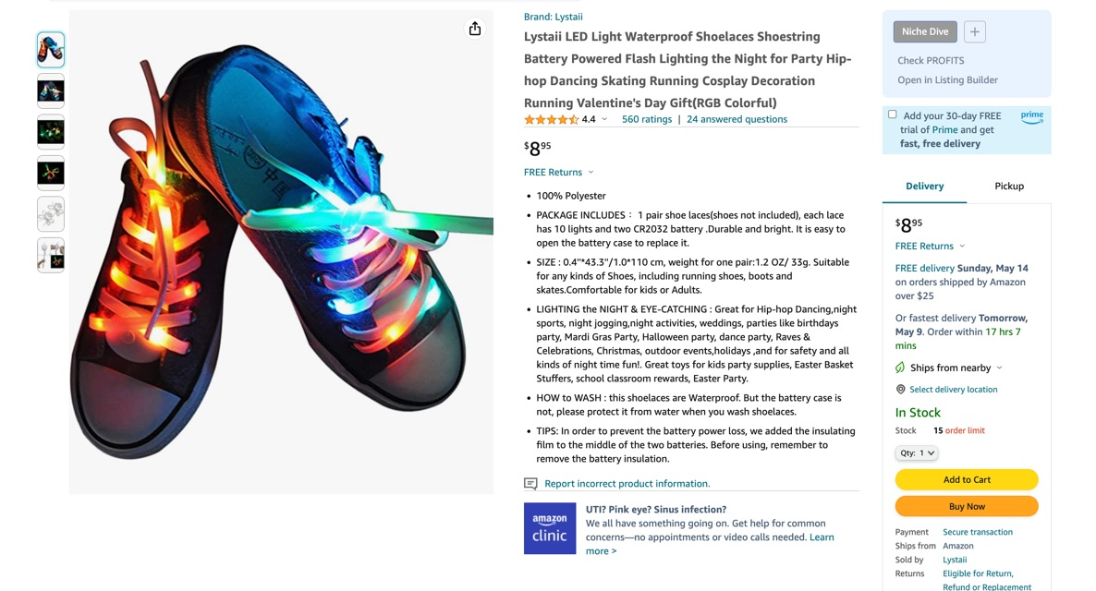
The Listing Structure: Bullet Points - Example 2.2
Bullet points - One example for better optimized, better bullets, tried to stand out in main image (partially succeeded)
דניאל ברלי | השקת מוצר

Slide 31
The listing Structure: The Description
Description
More “real-estate” for information we had no room in the bullets, title, images…
2 types of description: 1 - Regular, 2 - EBC (If we have brand registry) we can add there images (elaborating in a bit ok….(-:), but in general looks MUCH better.
In Cell Phones - Description / EBC sometimes placed before the bullet points, unlike the web (changing back). EBC triple better!!!
Sometimes when this happens, description shows its 1st 200 characters, so have there the most vital info first.
Usually 2,000 character, No emojis or HTML (aside from line breaks <br>). Keep it clean.
It does get indexed, but lower strength than Bullet points, therefore use whatever is left from secondary Kws + 3rd level Kws.
Have more room for storytelling and creativity of your story/brand
דניאל ברלי | השקת מוצר

Slide 32
The Listing Structure: EBC/A+
The Benefits of Enhanced Brand Content:
Visual
You can add MORE real estate, Images, tables, edited text …
Allows you to provide more information. Great place for Infographics.
You can choose the type of display you want out of few options (Modules)
Promotional & Operational
Increases customer experience conversions (sales) will improve ranking, relevance…
More professional (Adds to your conversion)
Cross promote other products
KWs in it can be indexed in google or other search engines (Not in Amazon)
Rules : …..
דניאל ברלי | השקת מוצר

Slide 33
The Listing Structure: EBC/A+ - 2
The Benefits of Enhanced Brand Content:
Rules:
2 types: Both need Brand Registry
A+ : 5 Modules, high resolution large images, better communication with customers, comparison table, Mobile friendly….
A++: All of A+ and 2 more modules, higher resolution images, Images with text, videos & V-layouts, carousel image, more types of modules to choose from….
Our design/Images/text/layout/Video first needs to be approved
No price/deals presentations - Its a BRAND display page, not a pure Sales page/section.
דניאל ברלי | השקת מוצר

Slide 34
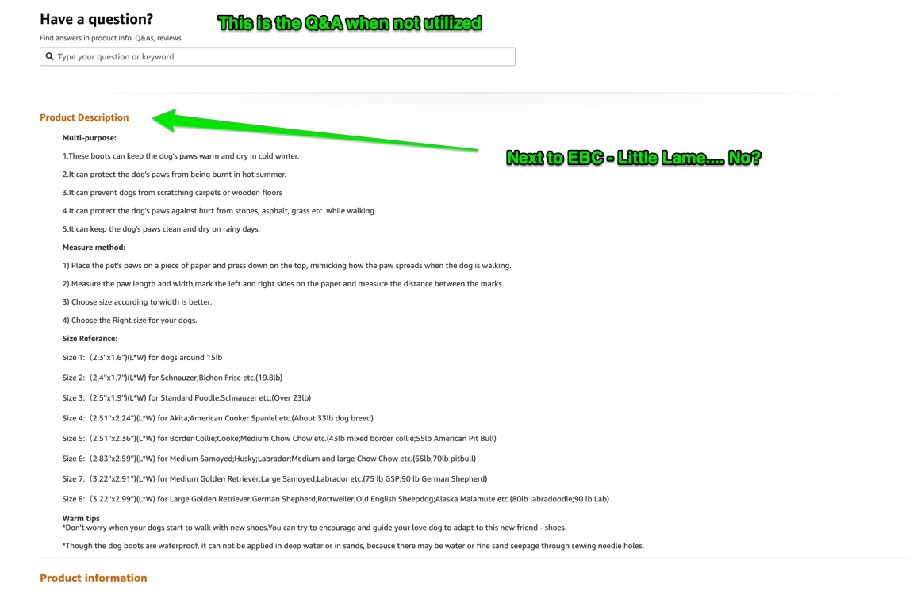
Listing Structure: The Description - 2
Description
דניאל ברלי | השקת מוצר

Slide 35
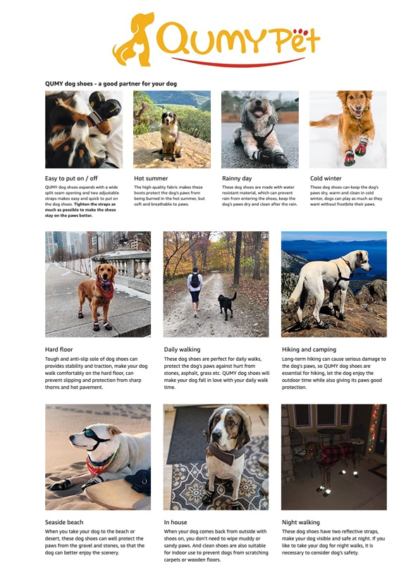
Listing Structure: The EBC Description - 2
Isn’t it cooler?
דניאל ברלי | השקת מוצר

Slide 36
The Listing Structure: EBC (A+ / Premium A+)
The Benefits of Enhanced Brand Content:
No EBC:
With A+
With A++ (#1)
With A++ (#2)
When could we join Premium A++?
When we will have several products which all are already on A+ & A certain amount of approvals for A+ (currently 15), so there is what to aspire to on this, not for the beginning.
דניאל ברלי | השקת מוצר

Slide 37
Listing Structure: The Q&A
Many neglect this section when it can be used in high efficiency. By using this well, you gain more real estate, impression and an edge on those who don’t:
Bad Qs, Bad answer if you wont join in (Its allowed as the seller), you will get “bad publicity”.
KWs can be placed there, as well as Images.
Today, relatively new - Can Add to your answer also a video - HOW BIG IS THAT!!
Sometimes if used correctly, can push the “bad” Qs down and have better Qs push up (the white ain’t as white as yesterday, but still fairly bright, as long as you are responding as the seller)
Now, there is also a soft point - Bad actors can use it against us - So vigilance!
OK, So how about some other idea that I heard of …. 😎
דניאל ברלי | השקת מוצר

Slide 38
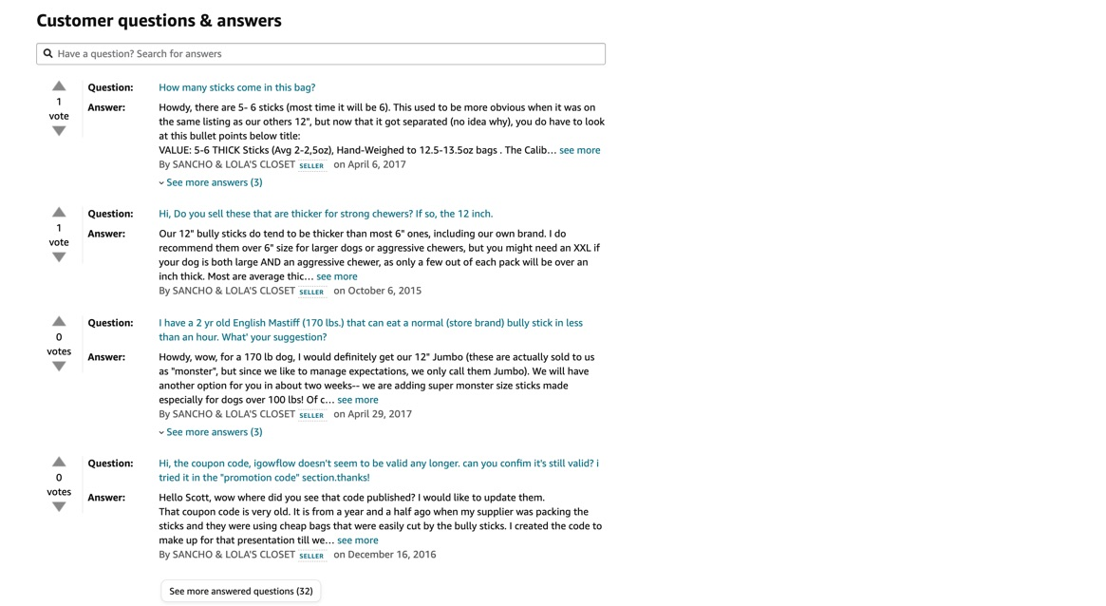
Listing Structure: The Q&A
דניאל ברלי | השקת מוצר

Slide 39
The listing Structure: Back-End KWs & More
Back-End side
More room for KWs
Generally 250 bytes
Back-End side is where we edit our listing. This the customer do not see. Visible only to amazon and the seller.
We can add there KW that we have not found place in our listing like, weaker Kws
Kws that you found no logic in placing but they have ranking/searching meaning still
Spanish words in US (Spanish in USA, slang, professional common terms)
No need for both plural and singular version of the word.
There are other ways and places to add more KW in the backend, but this is the most common (subject matter…).
Here also – No other’s brands.
For the rest of the info of our product, like:
You can enter also size, weight, other features of the product.
What ever you can fill it is good, as long as under the guidelines. - Has Importance!
Parent Child variation
דניאל ברלי | השקת מוצר

Slide 40
The listing Structure: The Back-End - 1
The Behind the store view
דניאל ברלי | השקת מוצר

Slide 41
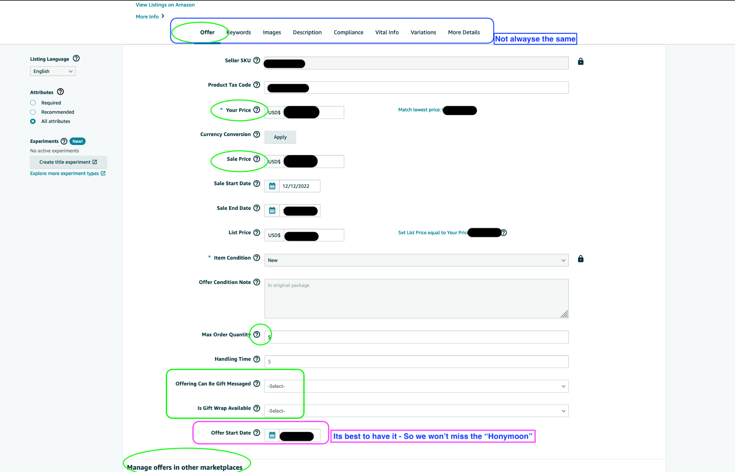
The listing Structure: The Back-End - 2
דניאל ברלי | השקת מוצר

Slide 42
The listing Structure: The Back-End - 3
דניאל ברלי | השקת מוצר

Slide 43
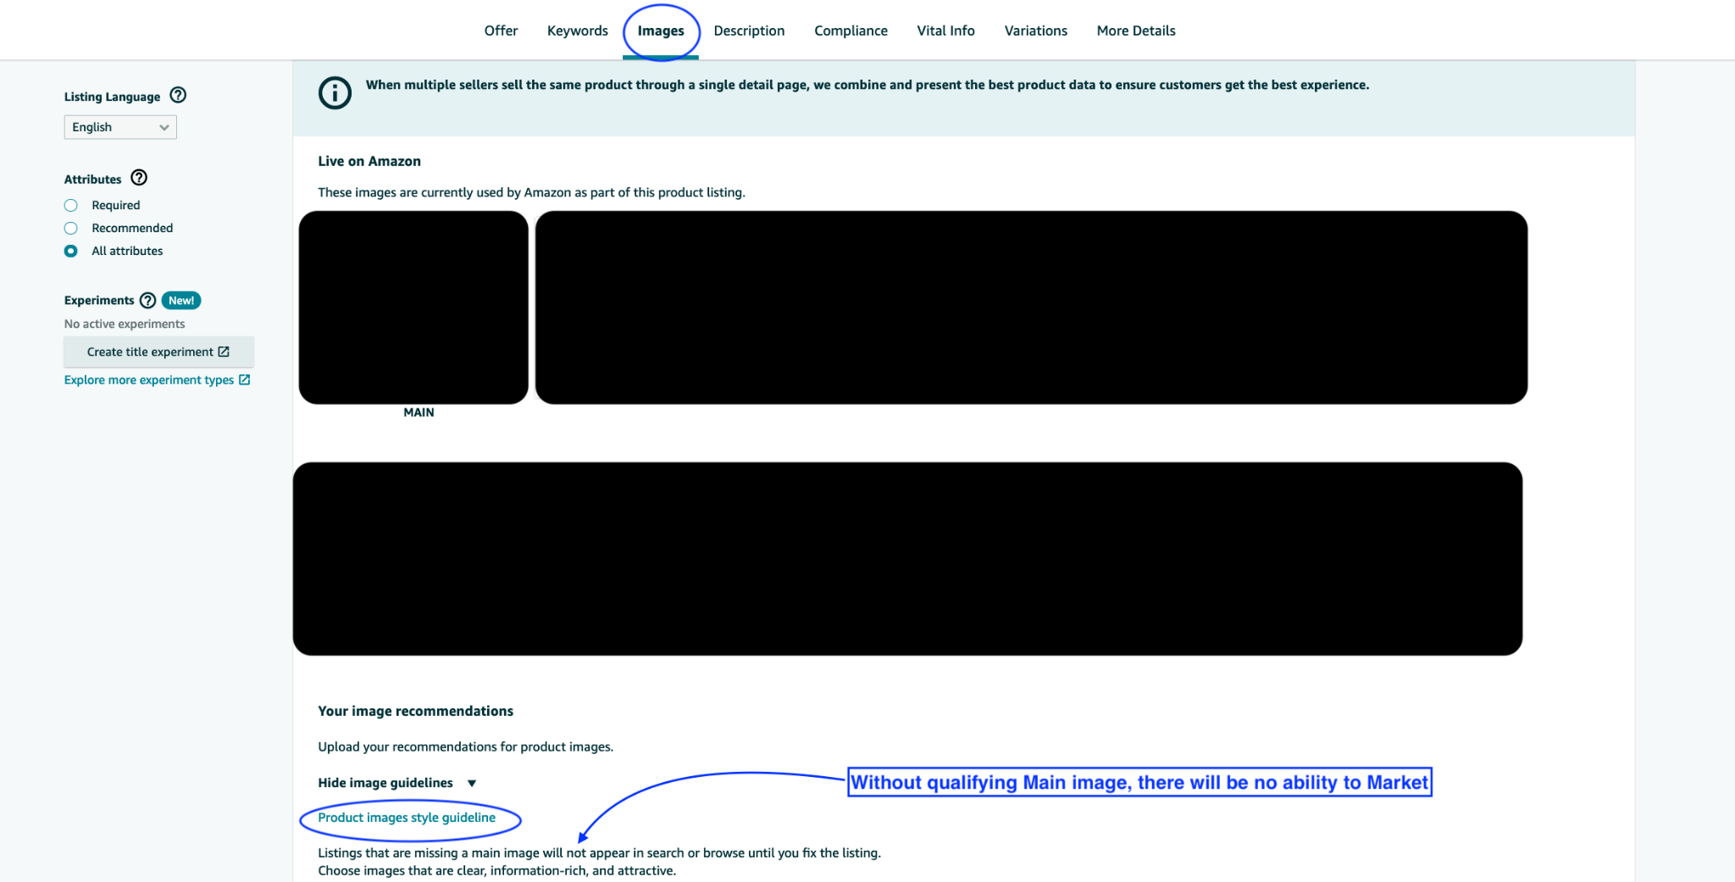
The listing Structure: The Back-End - 4
דניאל ברלי | השקת מוצר

Slide 44
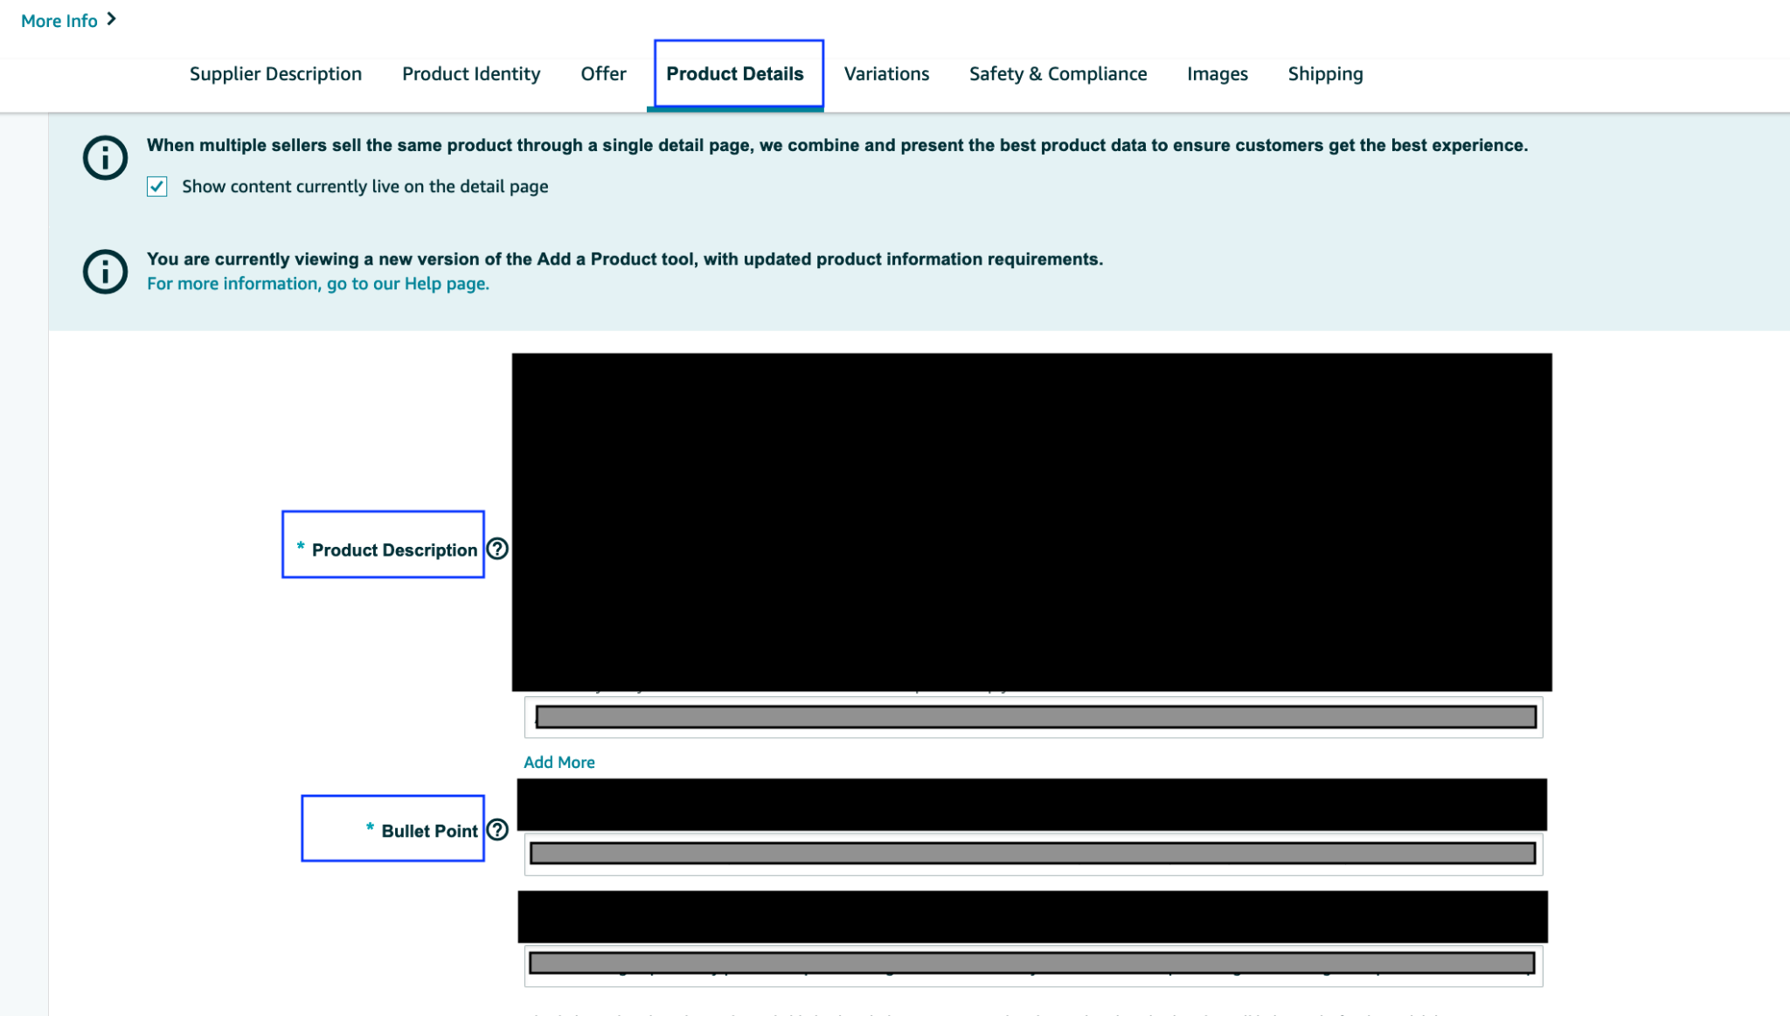
The listing Structure: The Back-End - 5
דניאל ברלי | השקת מוצר

Slide 45
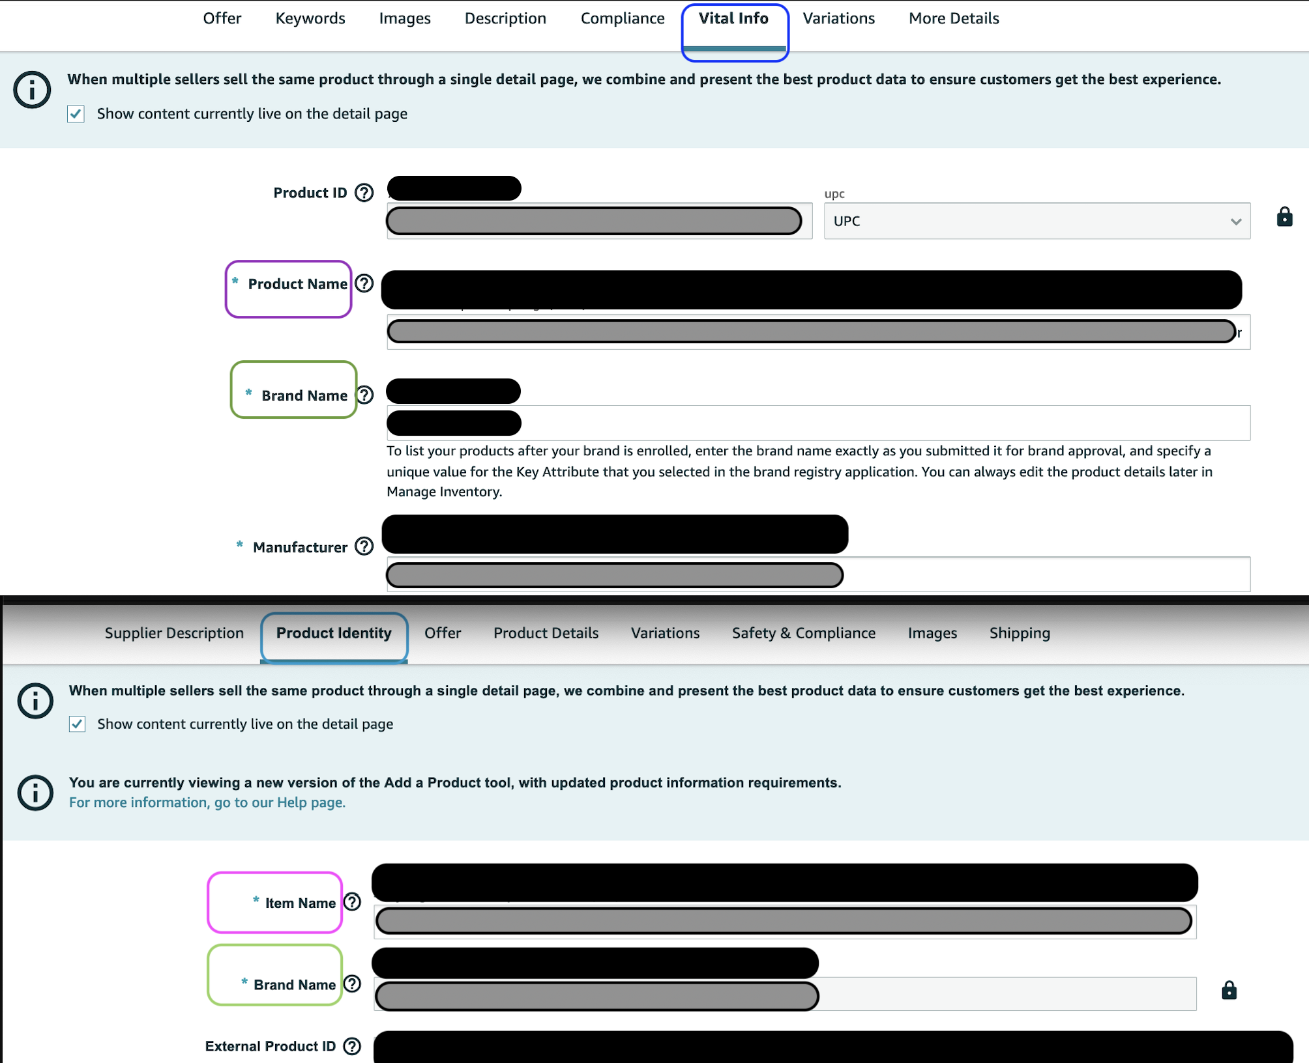
The listing Structure: The Back-End - 6
דניאל ברלי | השקת מוצר

Slide 46
The listing Structure: The Back-End - 7
דניאל ברלי | השקת מוצר

Slide 47
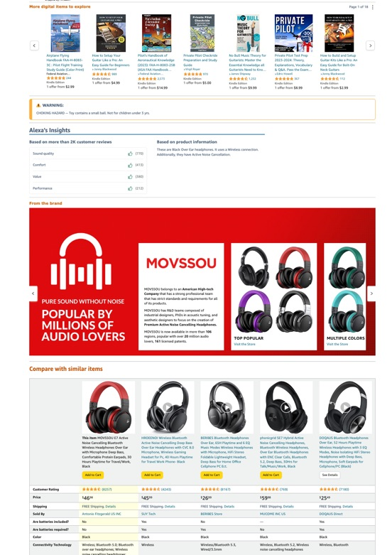
The listing Structure: From the Brand
Let’s go in
דניאל ברלי | השקת מוצר

Slide 48
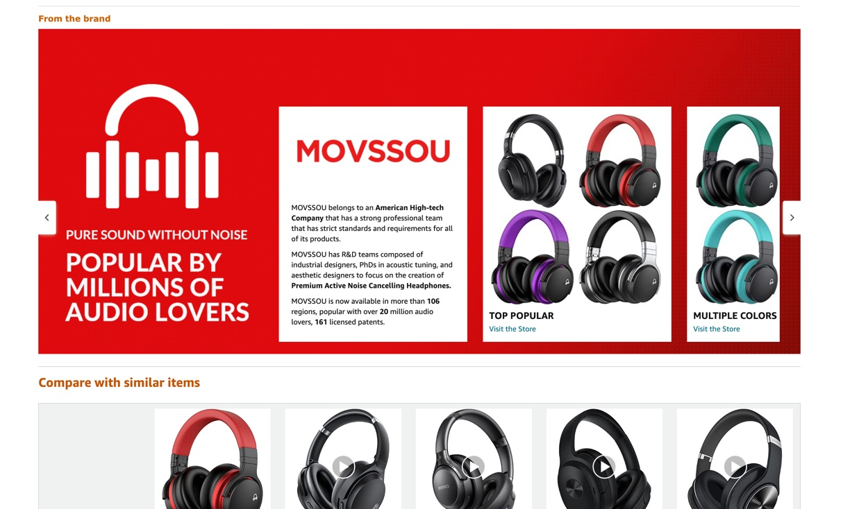
The listing Structure: From the Brand - 2
Ability to provide with our brand story and also present many other products for cross sell or provide more info on our listing’s product
דניאל ברלי | השקת מוצר

Slide 49
The listing Structure: Store Front
Creating a designated “Inner site” in Amazon for presenting our own Brand.
Need a Brand Registry
Sometimes potential/return buyers will go to the brand name to see what else is offered
We can add:
Cross sell products
Our social media channel
Offer deals
Connect from the posts
Amazon customer can follow us on amazon & we can directly market to them, notify on new products, cross sell….. A site with-in Amazon.
There are limitations of design and what can you present, but mostly free hand.
Videos inside the brand store, get indexed in Google
דניאל ברלי | השקת מוצר

Slide 50
The Listing: Protect its ability to convert
Some more ideas to protect the listing and conversions:
By using good ASA (sponsored ads) tactics, creating defence adds
Making sure it complies with the Listing guidelines
Respond fast to negative factors in it (Q&A…)
Making sure to fill with our products the frequently bought together
Fill all video presentation locations, with our videos (Grill Gloves)
דניאל ברלי | השקת מוצר

Slide 51
The listing Structure: So Much Work
We need to remember, we start probably with 1-2 products (if has variations). We can handle it and we should. The best way to learn.
So just a little touch on “help” (its a much bigger subject).
Freelancer: Always possible to take and in time it becomes a must and the wise decision.
They can help with building the listing, arranging the images, translation and proofreading text, KW research and more….
Pros:
Takes much of the load, they become better at their specific assignments, you don’t work alone anymore, more time for the big assignments, (your time becomes more expensive than the salary you pay)…
Cons (not many but):
The timing we choose for this is important (not too early, not too late), exposing to others lack of dedication, becoming little “too” dependant.
Ongoing: Some assignments we need to make sure we stay “on-top”. It always depends on our judgment of what assignment has been delegated.
דניאל ברלי | השקת מוצר

Slide 52
Thank You
www.negev-prime.com

